Slide 1

Credit Risk Prediction
Understanding, Predicting, and Mitigating Default Risk
Your Name: Andrei Bitca
Course / Program: Data Analytics with Artificial Intelligence

Slide 2

Credit Risk: Understanding the Challenge
What is Credit Risk?
Why is Predicting Credit Risk Important?
Credit risk refers to the possibility of a borrower failing to meet their debt obligations (like credit card payments).
Mitigating Financial Losses: Accurately identifying clients at high risk of default allows institutions to take proactive measures, minimizing financial write-offs.
For financial institutions, this translates directly into potential financial losses.
Informing Lending Decisions: Provides data-driven insights to make smarter choices about offering credit, setting limits, and determining interest rates.
Optimizing Customer Strategies: Enables tailored approaches for different risk segments, from offering support to high-risk individuals to nurturing loyal, low-risk clients.
Our Project's Goal:
To leverage historical data to analyse and identify key factors that drive credit card default.
To build and evaluate predictive models that can forecast a client's likelihood of defaulting on future payments.

Slide 3

Business Questions & Goals
1
Which features most influence credit default?
Why this matters: Understanding the most impactful factors allows financial institutions to pinpoint core risks and focus their efforts.
2
What customer groups are most at risk?
Why this matters: Identifying specific segments (e.g., by demographics or financial behaviour) enables targeted risk management and tailored customer strategies.
3
Can we predict default risk with a model?
Why this matters: Building reliable predictive models provides a powerful tool for proactive risk assessment, helping to minimize future losses.
4
Overall Business Goals:
To equip financial institutions with data-driven insights to minimize financial losses associated with credit card defaults.
To enable more informed and precise lending decisions, fostering healthier financial portfolios.
To support the development of proactive customer management strategies, potentially reducing defaults before they occur.

Slide 4

Dataset Overview
Source:
Dataset Size:
We utilized a publicly available dataset titled "Default of Credit Card Clients Dataset", sourced from the UCI Machine Learning Repository.
This robust dataset comprises detailed information on 30,000 credit card clients.
What the Data Contains:
For each client, the dataset provides a comprehensive view:
Demographic Information: Gender, Education Level, Marital Status, and Age.
Financial Information: Their Credit Limit, detailed Bill Amounts for the past six months, and Payment Amounts made over the same period.
Payment History: Records indicating any Payment Delays for each of the past six months.
Key Outcome (Target Variable): Whether the client ultimately defaulted on their next payment.

Slide 5
Approach & Tools
Data Preparation
Exploratory Data Analysis (EDA)
This initial phase involved cleaning, transforming, and organizing the raw dataset to ensure its quality and readiness for analysis. We handled missing values and prepared features.
We delved into the data to uncover initial patterns, distributions, and relationships between various factors and credit default. This helped us understand the data's story.
Feature Engineering
Statistical Analysis
We created new, more insightful variables from existing data (e.g., Total Bill Amount, Payment Delay Count) to improve the predictive power of our models.
We performed formal statistical tests to validate our hypotheses about the relationships between different data points and credit default.
Machine Learning Modelling
Dashboarding & Communication
We built and evaluated various predictive models to forecast the likelihood of a client defaulting.
The final step was to create interactive dashboards to visually present our findings and make the insights easily accessible.
Key Tools Utilized:
Python: Our primary tool for all data manipulation, in-depth analysis, statistical testing, and the development of machine learning models. We specifically used libraries like pandas, numpy, scikit-learn, matplotlib, and seaborn.
Tableau: Used for designing and building interactive, user-friendly dashboards that effectively communicate our key findings and model performance.

Slide 6
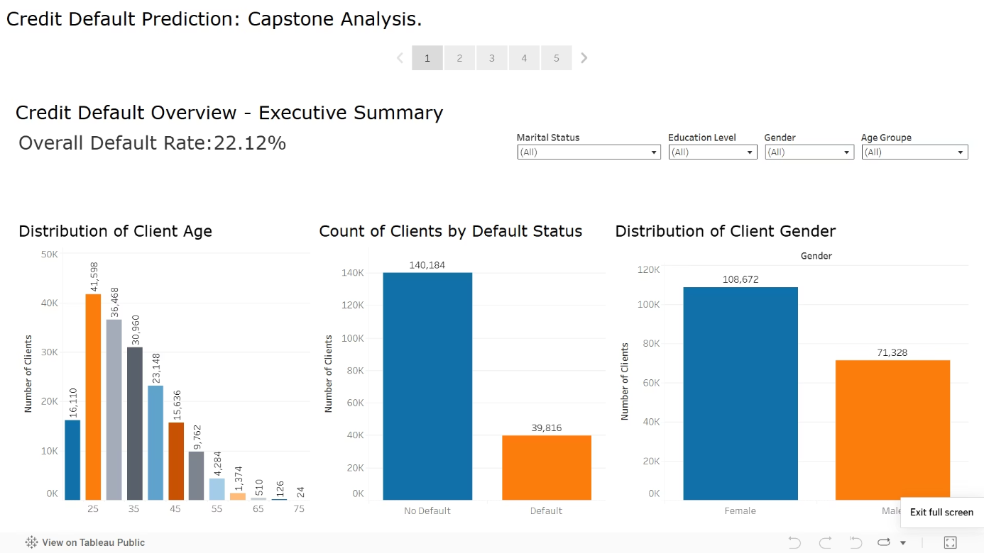
Key Findings: The Overall Picture of Default
The Overall Default Rate:
General Client Demographics:
Our analysis revealed an overall credit default rate of 22.12% among the clients in this dataset.
Gender Distribution: The dataset shows a distribution of 108,672 Female clients and 71,328 Male clients.
This indicates that approximately 1 in 5 clients did not meet their payment obligations, highlighting a significant area of risk.
Age Distribution: The largest groups of clients fall within the 25-35 year range, with a significant number in their 20s. For instance, there are 41,598 clients aged 25 and 36,468 clients aged 30.
Specifically, out of 179,996 clients, 39,816 defaulted while 140,184 did not.
Note: While these overall distributions are important for context, we will delve into how default rates vary by these demographics on the next slide.

Slide 7
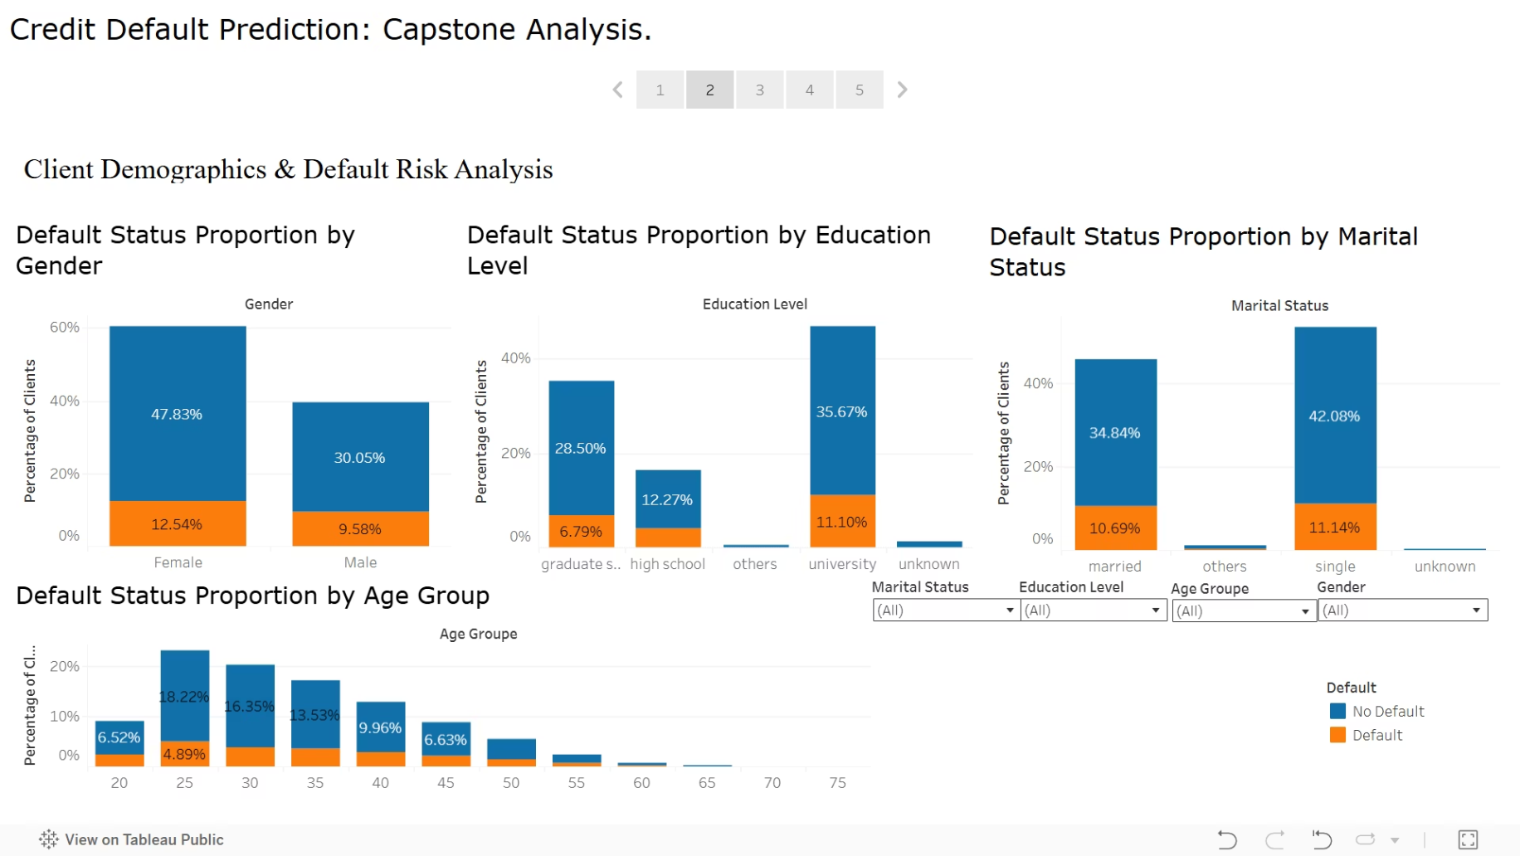
Key Findings: Demographics and Default Propensity
Gender:
Education Level:
Marital Status:
Age Groups:
Our analysis indicates that Male clients have a slightly higher default rate (24.17%) compared to Female clients (20.77%).
Education appears to be a notable factor. Clients with High School education show the highest default rate at 24.39%.
Married clients exhibit a slightly higher default rate of 23.48% compared to single clients at 20.93%.
The youngest age group (20 years old) shows the highest default rate at 26.35%.
Generally, the default rate tends to decrease as age increases, with the lowest rates observed in the older age groups (e.g., 55 years old at 14.91%).
(While females represent a larger percentage of overall clients, males show a higher propensity to default within their group.)
This is closely followed by clients with Graduate School education at 23.73%.
Clients with University education had a lower default rate of 19.24%.

Slide 8
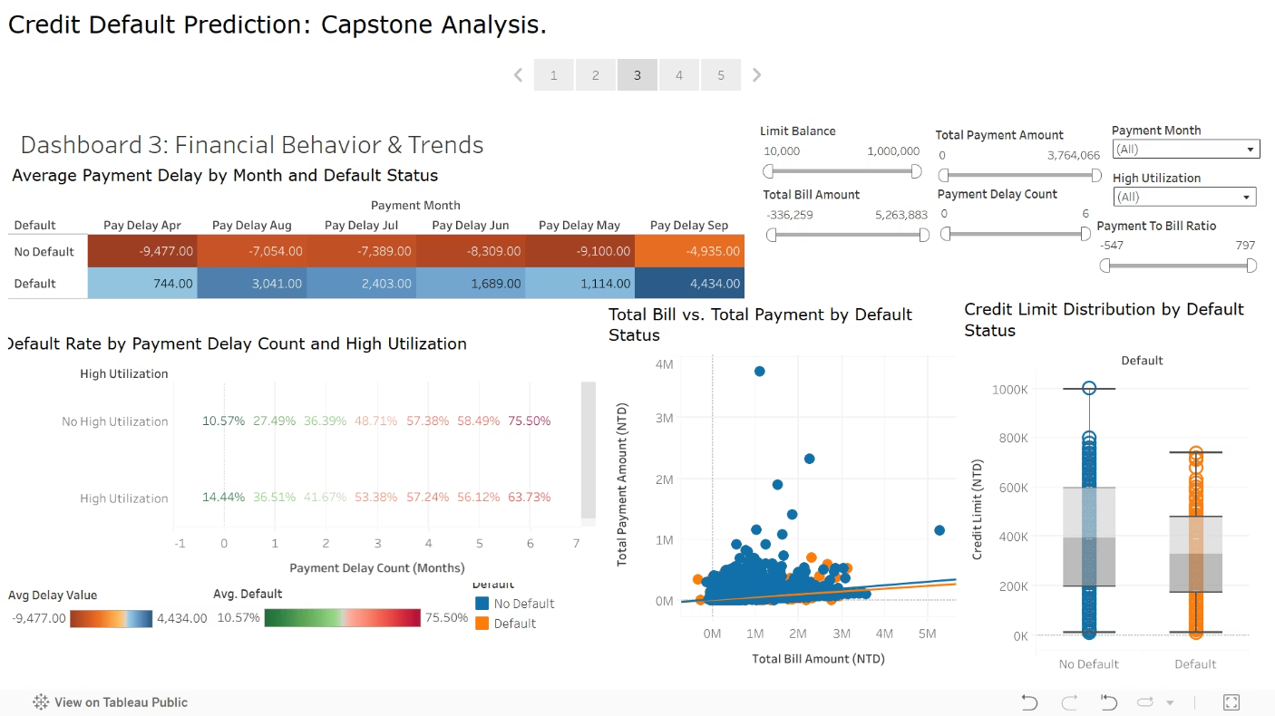
Key Findings: Financial Behaviour - The Strongest Predictors
Payment Delays are a Major Indicator:
Impact of High Utilization:
Bill vs. Payment Patterns:
Credit Limit Distribution:
Our analysis clearly shows a stark contrast: non-defaulting clients typically have negative average payment delays (meaning they pay on or before the due date, e.g., an average of -9,477 for April payments).
When combined with payment delays, High Utilization (meaning a high percentage of their credit limit is being used) consistently increases the default rate across most payment delay counts. For example, at 0 payment delays, the default rate jumps from 27.49% (no high utilization) to 36.51% (high utilization).
The scatter plot visually confirms that defaulters (orange dots) tend to have higher total bill amounts relative to their total payments, suggesting they are struggling to keep up with their balances.
Clients who defaulted generally possess lower credit limits compared to non-defaulting clients. This could indicate that those with lower initial creditworthiness are more susceptible to default, or that they are granted lower limits due to existing risk factors.
In contrast, defaulting clients consistently show positive average payment delays (meaning they pay after the due date, e.g., an average of 744 for April payments), indicating a pattern of late payments.
Non-defaulters (blue dots), on the other hand, typically show a healthier balance between bills and payments, or lower overall bill amounts.
The default rate drastically escalates with the number of payment delays. For instance, clients with 5 payment delays show a staggering default rate of 75.50% (for those with no high utilization). Even with High Utilization, 5 payment delays still result in a 63.73% default rate.

Slide 9
Building Predictors: Our Machine Learning Approach
What is Predictive Modelling?
Our Model Selection Strategy
Predictive modelling uses algorithms to analyse historical data and identify patterns.
We focused on establishing a strong baseline using commonly recognized and interpretable classification algorithms.
These patterns are then used to forecast future outcomes – in our case, whether a credit card client is likely to default.
These models help classify clients into "Default" or "No Default" categories.
Models We Implemented and Evaluated:
Logistic Regression:
Decision Tree:
K-Nearest Neighbors (KNN):
A statistical model used for predicting binary outcomes (like default/no default).
A tree-like model that makes decisions by splitting data based on various features.
A non-parametric model that classifies a data point based on how its "neighbors" (similar data points) are classified.
It's known for its interpretability, showing how each factor contributes to the likelihood of default.
It mimics human decision-making and can easily show the rules leading to a prediction.
It's effective for complex decision boundaries but can be computationally intensive.

Slide 10
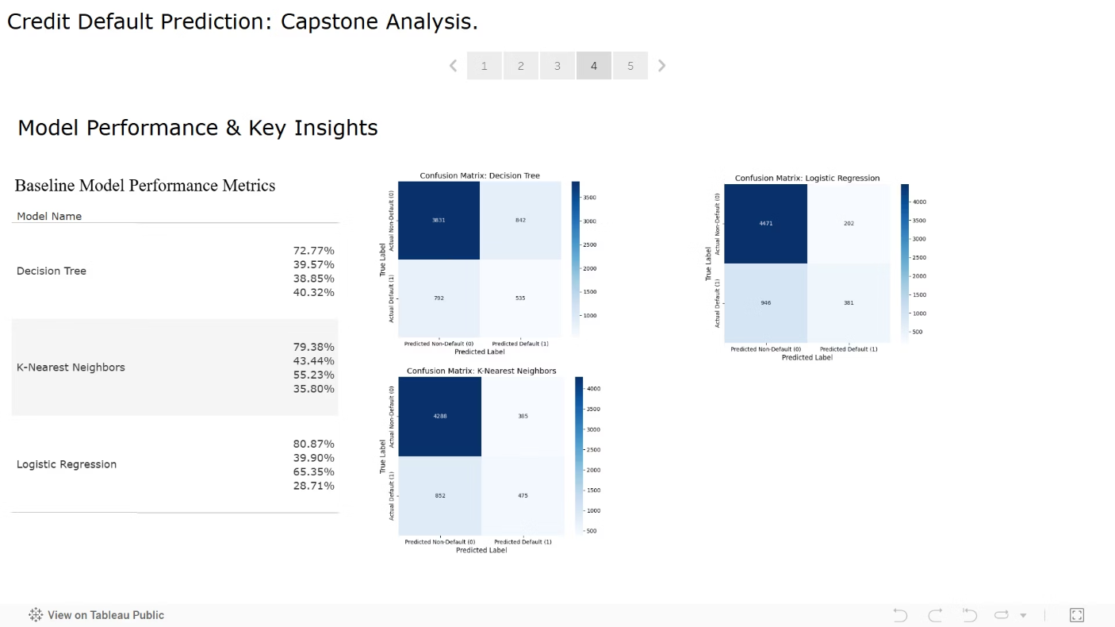
Predictive Power: Model Performance & Insights
Understanding Our Key Metrics:
1
Accuracy:
2
Precision (Default):
Overall correctness of the model's predictions (both defaulters and non-defaulters).
Of all clients predicted to default, how many actually did? (Minimizes false positives - predicting default when they don't)
3
Recall (Default):
4
F1-Score (Default):
Of all clients who actually defaulted, how many did the model correctly identify? (Minimizes false negatives - missing actual defaulters). This is often the most critical metric for credit risk as it directly impacts loss prevention.
A balance between Precision and Recall.
Overall Accuracy:
Identifying Defaulters (Recall):
Precision vs. Recall Trade-off:
For credit risk, our primary goal is to minimize missed defaulters. The Decision Tree model demonstrated the strongest ability to correctly identify actual defaulting clients, with a Recall of 40.32%. This means it was more successful at catching potential losses, even if its overall precision was lower.
While Logistic Regression had higher precision (fewer false alarms), its lower recall suggests it missed more true defaulters. The choice of model depends on the business's tolerance for false positives versus false negatives.
The Logistic Regression model achieved the highest overall accuracy at 80.87%.

Slide 11

Translating Insights into Action: Recommendations
Proactive Intervention for High-Risk Accounts:
Refined Credit Assessment & Limit Setting:
Focus on Payment Behaviour: Actively monitor for clients showing consistent payment delays (e.g., 2 or more months past due) and those with high credit utilization. Our analysis shows default rates significantly escalate in these groups (e.g., up to 75.50% for clients with 5 delays).
Integrate Behavioural Data: Incorporate historical payment behaviour and utilization patterns more heavily into credit scoring models for new and existing clients.
Adjust Credit Limits: Based on predictive model scores, adjust credit limits to align with a client's risk profile, potentially reducing exposure for high-risk individuals.
Early Outreach: Implement automated alerts or human outreach programs (e.g., financial counselling, flexible payment plans) for clients showing these early warning signs, before they default.
Consider Demographic Nuances: While financial behaviour is primary, be mindful of demographic insights, such as the slightly higher default rate among males (24.17%) and clients with High School education (24.39%).
Optimized Resource Allocation based on Model Strengths:
Continuous Monitoring & Model Improvement:
Regularly monitor the performance of deployed models with new data to ensure their accuracy remains high.
Leverage Recall for Loss Prevention: Utilize models with higher Recall for Default (e.g., Decision Tree at 40.32%) to prioritize accounts for review. While this might lead to more false positives, it ensures fewer actual defaulters are missed, directly reducing potential losses.
Periodically retrain models and explore more advanced algorithms to capture evolving risk patterns.
Targeted Marketing/Support: Use model predictions to segment customers for tailored offers (e.g., lower interest rates for low-risk clients) or specific financial support programs.

Slide 12
Navigating Challenges & Paving Future Paths
Challenges Encountered
Future Enhancements & Roadmap
Data Imbalance: Dealing with the imbalance between defaulting and non-defaulting clients was a key challenge. A significantly smaller proportion of clients defaulted, which can make it harder for models to learn effectively.
Explore Advanced Models: Investigate more sophisticated machine learning algorithms like Gradient Boosting (e.g., XGBoost, LightGBM) or Neural Networks, which often yield higher predictive performance.
1
Feature Engineering Complexity: Identifying and creating truly impactful new features from the raw transactional data required careful thought and iterative experimentation.
Deepen Feature Engineering: Analyse payment history data at a more granular, time-series level to capture dynamic behavioural shifts.
2
Incorporate external data sources, such as economic indicators (e.g., unemployment rates, inflation), which could influence credit risk.
Model Interpretability vs. Performance: Balancing the desire for highly accurate models with the need for clear interpretability (especially for business stakeholders) was a consideration.
3
Advanced Sampling: Apply more advanced techniques to handle data imbalance (e.g., SMOTE, ADASYN) to potentially improve model performance, especially Recall.
Automated Monitoring: Develop a system for continuous monitoring of model performance in a production environment and automated retraining with fresh data to adapt to changing economic conditions and client behaviours.
4
Interactive Scenarios: Enhance the Tableau dashboards to allow users to explore "what-if" scenarios, helping them understand how changes in client behaviour might impact their risk profile.
5

Slide 13

Conclusion & Questions
Our journey through credit risk prediction has revealed powerful insights and practical applications. Let's recap the core value of this project.
Recap: The Value of This Project
Key Takeaways
Our "Credit Risk Prediction" project successfully analysed key factors influencing credit card default, demonstrating the power of data analytics in financial risk management.
Data-driven insights are indispensable for robust credit risk assessment.
Focusing on specific behavioral indicators can significantly improve prediction accuracy.
We identified critical behavioural patterns, such as payment delays and credit utilization, as strong indicators of default risk.
Machine learning models offer a powerful capability to enhance traditional risk management.
The predictive models developed provide a valuable tool for financial institutions to proactively identify and manage high-risk accounts, potentially preventing significant financial losses.
Thank You!

